Slide 1

www.espirity.com
Building GUIs with SWT
Dwight Deugo (dwight@espirity.com)
Nesa Matic (nesa@espirity.com)
Notes:
Portions of the notes for this lecture include excerpts from the Eclipse 3.0 Help facility. These excerpts are made available under CPL for ease of use by instructors, (c) Copyright (c) 2000, 2004 IBM Corporation and others. For more complete information instructors are encouraged to read the full notes from the Eclipse Help facility.

Slide 2
Additional Contributors
Carolyn MacLeod, IBM

Slide 3
Module Overview
SWT Basics
GUI Patterns

Slide 4
Module Road Map
SWT Basics
  SWT applications
  SWT terminology
  SWT layouts
GUI Patterns

Slide 5
SWT
Delivers native widget functionality for the Eclipse platform in an operating system independent manner
  Analogous to AWT/Swing in Java
Delivers functionality using a small and consistent API
  API is implemented on different platforms using a combination of Java code and JNI natives specific to each platform

Slide 6
SWT Application
Core Components
  Widgets, Layouts, Events
Structure
  Create a Display
  Create a Shell which serves as the main window
  Create other widgets that are needed inside the shell
  Initialize the state for the widgets
  Register listeners for widget events
  Open the shell window
  Run the event dispatching loop until an exit condition occurs
  Dispose the display

Slide 7
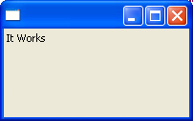
SWT Application Example
public static void main(String[] args) {
Display display = new Display();
Shell shell = new Shell(display);
shell.setLayout(new RowLayout());
Label label = new Label(shell, SWT.CENTER);
label.setText("It Works");
shell.open();
while (!shell.isDisposed ()) {
if (!display.readAndDispatch ()) display.sleep ();
}
display.dispose ();
}
Notes:
All swt widgets (dosplay, label, text, etc.) are defined in the package import org.eclipse.swt.widgets.*
SWT class is defined in the package org.eclipse.swt

Slide 8
Terminology
Display
  The connection between SWT and the underlying platform's GUI system
  Used to manage the platform event loop and control communication between the UI thread and other threads
Shell
  Window managed by the OS platform window manager
Composite
  Widget that has widget children

Slide 9
Layouts…
Controls the position and size of children in a Composite
Layout classes are subclasses of the abstract class Layout
SWT provides several standard layout classes, and you can write custom layout classes:
  FillLayout, places equal-sized widgets in a single row or column
  RowLayout, places widgets in a row or rows
  GridLayout, places widgets in a grid
  FormLayout, places widgets by creating attachments for each side
Notes:
You can simply use the arrows from the example above to indicate navigation in the slides.

Slide 10
Working with Layouts
You need to import the SWT layout package:
  import org.eclipse.swt.layout.*;
To set the Composite widget’s layout use widget’s setLayout(Layout) method
Display display = new Display();
Shell shell = new Shell(display);
shell.setLayout(new FillLayout());

Slide 11
Layout Data
A layout class uses a layout data class
  RowLayout -> RowData
  GridLayout -> GridData
  FormLayout -> FormData
Set a widget’s layout data class as follows:
Button button = new Button(shell, SWT.PUSH);
button.setLayoutData(new RowData(10, 20));

Slide 12
FillLayout
Lays out widgets in a row or column
All widgets the same size
No wrapping
You cannot specify margins or spacing
Use it to:
  Lay out buttons in a task bar or tool bar
  Stack checkboxes in a Group
Notes:
If a Shell has a single Group child, FillLayout will cause the Group to completely fill the Shell.

Slide 13
FillLayout Example…
Display display = new Display();
Shell shell = new Shell(display);
FillLayout fillLayout = new FillLayout();
fillLayout.type = SWT.VERTICAL;
shell.setLayout(fillLayout);
new Button(shell, SWT.PUSH).setText("1'st Button");
new Button(shell, SWT.PUSH).setText("Big Button");
new Button(shell, SWT.PUSH).setText("Button 3");
new Button(shell, SWT.PUSH).setText("Last Button");
shell.pack();
shell.open();

Slide 14
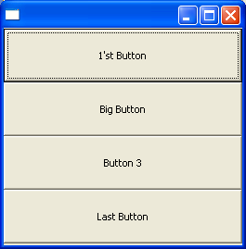
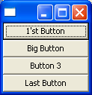
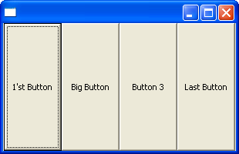

…FillLayout Example
fillLayout.type = SWT.VERTICAL;
fillLayout.type = SWT.HORIZONTAL;

Slide 15
RowLayout
RowLayout has the ability to wrap
Provides configurable margins and spacing
Various fields can be set
  The height and width of each widget can be specified
  Use the RowData object

Slide 16



RowLayout Example …
RowLayout rowLayout = new RowLayout();
rowLayout.wrap = true;
rowLayout.pack = true;
rowLayout.justify = true;
rowLayout.type = SWT.HORIZONTAL;
rowLayout.marginLeft = 4;
rowLayout.marginTop = 4;
rowLayout.marginRight = 4;
rowLayout.marginBottom = 4;
rowLayout.spacing = 0;
shell.setLayout(rowLayout);

Slide 17

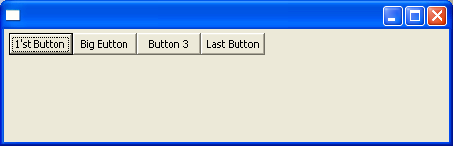
…RowLayout Example…
rowLayout.wrap = false;
rowLayout.pack = false;
rowLayout.justify = false;

Slide 18
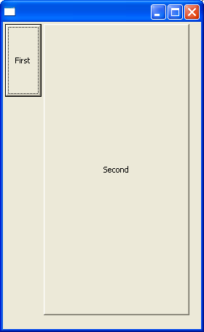
…RowData Example
RowLayout rowLayout = new RowLayout();
shell.setLayout(rowLayout);
Button button1 = new Button(shell, SWT.PUSH);
button1.setText("First");
button1.setLayoutData(new RowData(50, 100));
Button button2 = new Button(shell, SWT.PUSH);
button2.setText("Second");
button2.setLayoutData(new RowData(200, 400));

Slide 19
GridLayout
Most used layout
Most complicated too
Children of a Composite laid out in a grid
  columns/rows size to fit the children they contain
Various fields can be set
Widgets it lays out can have an associated GridData
  Provides the ability to configure GridData for each widget

Slide 20
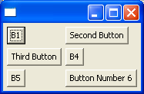
GridLayout Example
GridLayout gridLayout = new GridLayout();
gridLayout.numColumns = 2;
shell.setLayout(gridLayout);
new Button(shell, SWT.PUSH).setText("B1");
new Button(shell, SWT.PUSH).setText("Second Button");
new Button(shell, SWT.PUSH).setText("Third Button");
new Button(shell, SWT.PUSH).setText("B4");
new Button(shell, SWT.PUSH).setText("B5");
new Button(shell, SWT.PUSH).setText("Button Number 6");

Slide 21
GridLayout Fields
Fields
  makeColumnsEqualWidth field forces the columns to be the same width
  marginWidth specifies left and right margins
  marginHeight specifies top and bottom margins
  horizontalSpacing and verticalSpacing can be specified independently

Slide 22
GridData
Represents layout data object associated with GridLayout
Set a widget’s GridData object using the setLayoutData method
Button aButton = new Button(shell, SWT.PUSH);
aButton.setText("FirstButton");
aButton.setLayoutData(new GridData());

Slide 23
GridData Fields…
horizontalAlignment: specifies where to place a widget horizontally and/or vertically within its grid cell
  BEGINNING, CENTER, END, FILL
horizontalIndent: allows you to move a widget to the right by a specified number of pixels
  Usually useful when the horizontalAlignment is BEGINNING
horizontalSpan and verticalSpan: lets widgets occupy more than one grid cell

Slide 24
…GridData Fields
grabExcessHorizontalSpace and grabExcessVerticalSpace: allow widgets to grow if their containing Composite grows
widthHint and heightHint: identify a widget’s number of pixels wide or tall

Slide 25
GridData Example…
GridLayout gridLayout = new GridLayout();
gridLayout.numColumns = 3;
shell.setLayout(gridLayout);
…
Text userName = new Text(shell, SWT.SINGLE | SWT.BORDER);
GridData gridData = new GridData(GridData.HORIZONTAL_ALIGN_FILL);
gridData.horizontalSpan = 2;
userName.setLayoutData(gridData);
…
Each widget must have its own instance of grid data

Slide 26
…GridData Example…
Combo sex = new Combo(shell, SWT.NONE);
sex.setItems(new String [] {"Male", "Female"});
gridData = new GridData(GridData.HORIZONTAL_ALIGN_FILL);
gridData.horizontalSpan = 2;
sex.setLayoutData(gridData);
new Label(shell, SWT.NONE).setText("Photo:");
Canvas photo = new Canvas(shell, SWT.BORDER);
gridData = new GridData(GridData.FILL_BOTH);
gridData.widthHint = 80;
gridData.heightHint = 80;
gridData.verticalSpan = 3;
photo.setLayoutData(gridData);

Slide 27
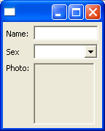
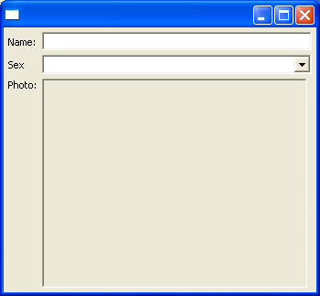
…GridData Example

Slide 28
FormLayout
Creates FormAttachments for sides of the widget
  Stores the attachments in the layout data
  Attach side to a position in the parent Composite or to another widget within the layout
Allows you to fully specify the placement of widgets in the layout

Slide 29
FormLayout Fields
The margin fields in FormLayout are the same as in GridLayout
  marginWidth: defines left and right margins
  marginHeight: defines top and bottom margins
Margins can also be defined on a per-widget basis in the attachments
  FormLayout margins are 0 by default

Slide 30
FormData Fields
left, right, top and bottom fields of FormData specify the FormAttachment objects
There are many ways that a side can be attached to a position in the parent Composite:
  Edge of the Composite
  Adjacent side of another widget
  The opposite side of another widget
  Centered on another widget
To attach to an edge of the Composite, the percentage is either 0% or 100%
width and height fields of FormData specify the requested width and the height of the widget

Slide 31
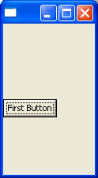
Attaching to a Position
Set the top of the Button to a position that represents 50% of the height of the parent Composite (a Shell), with an offset of 0
shell.setLayout(new FormLayout());
Button aButton = new Button(shell, SWT.PUSH);
aButton.setText("First Button");
FormData formData = new FormData();
formData.top = new FormAttachment(50,0);
aButton.setLayoutData(formData);

Slide 32
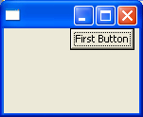
Attaching to a Parent
Attaches the right side of the Button to the right edge of the parent (a Shell), with an offset of 5 pixels
shell.setLayout(new FormLayout());
Button aButton = new Button(shell, SWT.PUSH);
aButton.setText("First Button");
FormData formData = new FormData();
formData.right = new FormAttachment(100,-5);
aButton.setLayoutData(formData);

Slide 33
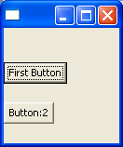
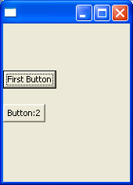
Attaching to Another Widget
aButton will move so that its top side is always positioned at 30% of the Shell, and anotherButton will move so that its top side is always 20 pixels below the adjacent (bottom) side of aButton
shell.setLayout(new FormLayout());
Button aButton = new Button(shell, SWT.PUSH);
Button anotherButton = new Button(shell, SWT.PUSH);
aButton.setText("First Button");
anotherButton.setText("Button:2");
FormData formData1 = new FormData();
FormData formData2 = new FormData();
formData1.top = new FormAttachment(30,0);
aButton.setLayoutData(formData1);
formData2.top = new FormAttachment(aButton,20);
anotherButton.setLayoutData(formData2);
aButton.setLayoutData(formData1);

Slide 34
Module Road Map
SWT
GUI Patterns
  View Event Handler Pattern
  Complete Update Pattern
Notes:
The module road map slide gives a view on what sections are in the module and what are the topics covered in the current section.

Slide 35
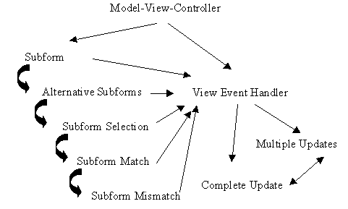
GUI Patterns
View Event Handler
Complete Update Pattern
Goal
  Describe how to build GUIs that are easy to debug, modify and maintain

Slide 36
Global Context
You are developing a new View or ViewPart subclass
The widgets contained in your new view have a low degree of dependencies between one another
The widgets use the Observer pattern to notify the views of changes

Slide 37
Global Forces
A view’s functionality changes often
A significant period may elapse between the time a developer last worked on a view and the time he is making changes to it
The original developer of a view is not always the same person that maintains or extends it
Tightly coupled widgets are difficult to merge or split
Visual containers that have many constraints between their visual components, such as tree views and grids, are difficult and time consuming to update
A large percentage of time is required for GUI development
Unique view designs are more difficult to support than consistent ones
Since a view is a user’s entry point into an application, it must be user friendly

Slide 38
View Event Handler Pattern…
Context
  You have incorporated the Observer pattern into your view’s design
  Your view is interested in receiving event messages from its observable widgets when specific events occur in them
  Your view needs to collaborate with one or more model objects in order to handle these notification messages and then update its widgets in response
  You want your view to update its widgets in an organized, linear manner, so that regions of the view update together rather than in an apparent random manner

Slide 39
…View Event Handler Pattern…
Problem
  How should a view handle event notifications from its observable widgets
    So it does not create any updating dependencies between the methods
    The number of updates to the widgets is minimized?

Slide 40
…View Event Handler Pattern…
Forces
  Many observable widgets can generate identical event messages
  You can use a case statement to determine which widget sent the event message and how to process it in a single handler method
  Setting flags when handling event messages in order to decide which observable widget to update ensures that you don't perform any redundant updates
  If the handling of a single event message results in many changes to your view’s model, the MVC pattern forces the model to send notification messages to its corresponding widgets several times

Slide 41
…View Event Handler Pattern
Solution
  In your view, create and register a handler method for each event message from your widgets
  Do not register your views with the models
  Your view’s handler method should pull information from the appropriate widgets when invoked and then invoke the corresponding services in the models
  Your handler method should not do any updating of the widgets itself
  Have your handler use a single update method that is responsible for updating all widgets

Slide 42
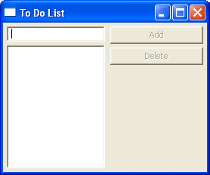
View Event Handler Pattern Example
public class ToDoListView {
private static String EMPTYSTRING = "";
private Display display;
private Shell shell;
private Text toDoItemText;
private List todoItemsList;
private Button deleteButton, addButton;
private String newItem;
private Vector items;
private String selectedItem ;
…

Slide 43
Event Handling in Java
Anything that happens in UI causes an event to occur
Any object can be notified of the event
  Object must be registered as a listener for the event
listener 1
listener 2
event
UI component
listener 3
listener 4
…
listener n
Notes:
Event handling in Java is supported through the event listeners mechanism. Every widget in Java fires events, for example button is clicked, or list selection changes… To notify an object about specific event, object must be registered as a listener of that event. Multiple objects can be notified of the same event, i.e. there can be multiple listeners for the same event. Once an object is registered as event listener, when event occurs it is notified about the event, so it can handle the event.

Slide 44
Listeners
Listeners are Java mechanism for event handling
  Registering listeners means that object that registers them is interested in specific event
toDoItemText.addModifyListener(
new ToDoItemTextModifyListener());
todoItemsList.addSelectionListener(
new TodoItemsListSelectionListener());
addButton.addSelectionListener(
new AddButtonSelectionListener());
deleteButton.addSelectionListener(
new DeleteButtonSelectionListener());

Slide 45
Inner Classes
Classes that are defined within other classes
  They can be used only within the class where they are defined
  Anonymous inner classes are inner classes that have no name
Commonly used in:
  Concurrent programming (multi-threading)
  Event handling
    Using inner classes keeps the code that handles the event in the class that is interested in the event
Notes:
Inner classes are commonly used in the event handling in Java. Event handler class must either implement the listener interface or subclass a class that implements it, and it contains the code for handling the event.
When using the inner classes for implementing listeners, it means that the event handler code is tied to the class that registers for the listeners. This keeps the overall design and code clean.

Slide 46
Handling Events
Listeners implement event handling
public class ToDoListView {
…
public class AddButtonSelectionListener extends SelectionAdapter {
public void widgetSelected(SelectionEvent event) {
if (!getNewItem().equals(EMPTYSTRING)){
getItems().add(getNewItem());
setNewItem(EMPTYSTRING);
}
update();
}
}
…
}

Slide 47
Complete Update Pattern…
Context
  Used the View Event Handler pattern to develop your view that contains a small number of widgets that can be updated simultaneously in a reasonable amount of time
Problem
  How do you structure a view’s update mechanism?

Slide 48
…Complete Update Pattern…
Forces
  Changes in the view's model objects may be the result of the view’s action or of another object’s action the view does not know about
  Developer created flags indicating which widgets require updating in a view are complicated to understand for both the immediate and future developers
  You are not always the one who will maintain your views so the view's logic must be easily understood
  You can often improve performance by using tricky implementation techniques
  These tricks often complicate your code by making it less easy to read and comprehend
  You do not always know what has changed in your view’s models or which widgets need updating

Slide 49
…Complete Update Pattern…
Solution
  Assume the entire view is out-of-date and update everything
  Write a specialized write update method for each region of your view
  Each specialized update method is responsible for updating its corresponding widgets from information in the models
  Permit each specialized update method to load model information directly into the widgets or compute the contents on the fly
  Write a single, main update method that invokes all of the specialized update methods
  You can still be efficient by not loading model information that has not changed

Slide 50
Complete Update Pattern Example…
Single update method
private void update(){
updateAddButton();
updateDeleteButton();
updateToDoItemText();
updateTodoItemsList();
}

Slide 51
…Complete Update Pattern Example…
Update methods helpers
private void updateDeleteButton(){
deleteButton.setEnabled(!getSelectedItem().equals(EMPTYSTRING));
}
private void updateAddButton(){
addButton.setEnabled(!getNewItem().equals(EMPTYSTRING));
}
private void updateToDoItemText(){
if(!toDoItemText.getText().equals(getNewItem()))
toDoItemText.setText(getNewItem());
}

Slide 52
…Complete Update Pattern Example
private void updateTodoItemsList() {
String [] displayItems; Enumeration enumeration; int index;
  if(!(todoItemsList.getItems().length == getItems().size())){
  displayItems = new String[items.size()];
  enumeration = getItems().elements();
  index = 0;
  while (enumeration.hasMoreElements()){
  displayItems[index] = (String)enumeration.nextElement();
  index++;
  }
  todoItemsList.setItems(displayItems);
  }
}

Slide 53
Threading Issues…
Applications can not call UI code from a non-UI thread directly
Must provide a Runnable that calls the UI code
  Runnable interface is used for Java threading support
Display class used to execute runnables
  syncExec(Runnable)
  asyncExec(Runnable)

Slide 54
…Threading Issues
syncExec(Runnable)
  Use when the application code in the non-UI thread depends on the return value from the UI code
  Ensure that runable runs to completion before returing to caller
  SWT blocks caller until runnable completes
asyncExec(Runnable)
  Use when the application needs to perform some UI operations, but is not dependent upon the operations being completed before continuing
  SWT does not block caller" under asyncExec

Slide 55
Threading Pattern Example
Display.getDefault ().asyncExec (new Runnable () {
public void run () {
update();
}});

Slide 56
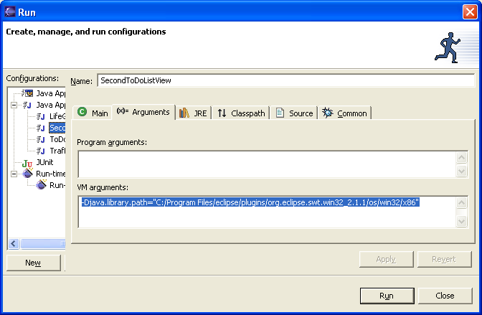
Magic
To run an SWT standalone application you need the following VM argument supplied in the Run window (note forward /’s):
  -Djava.library.path="C:/Program Files/eclipse/plugins/org.eclipse.swt.win32_3.0.0/os/win32/x86"
  where C:/Program Files/eclipse is replaced by your Eclipse install directory

Slide 57
Module Summary
In this module we have:
  Discussed SWT, native widget functionality for the Eclipse platform
  Examined different techniques for laying out your views using layout manager
    FillLayout
    RowLayout
    GridLayout
    FormLayout
  Described how to build maintainable GUI using patterns

Slide 58

Labs Slide!
Lab: Building GUIs with SWT
Notes:
The lab slide indicates that students are about to do the labs. It is usually at the end of section or at the end of entire module.

Slide 59
References
Understanding Layouts in SWT http://www.eclipse.org/articles/Understanding%20Layouts/Understanding%20Layouts.htm

